Slide 1

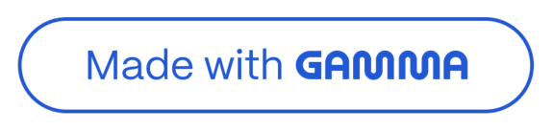
Customer Shopping Behavior Analysis
This project analyzes customer shopping behavior using transactional data from 3,900 purchases across various product categories. The goal is to uncover insights into spending patterns, customer segments, product preferences, and subscription behavior to guide strategic business decisions.

Slide 2

Dataset Summary
Key Features
Customer demographics (Age, Gender, Location, Subscription Status)
Purchase details (Item, Category, Amount, Season, Size, Color)
Shopping behavior (Discount, Promo Code, Previous Purchases, Frequency, Review Rating, Shipping Type)
Dataset Overview
Rows: 3,900
Columns: 18
Missing Data: 37 values in Review Rating

Slide 3

Exploratory Data Analysis with Python
Data Loading & Exploration
Imported dataset using pandas. Used df.info() and .describe() for initial checks.
Missing Data Handling
Imputed missing values in 'Review Rating' using the median rating per product category.
Column Standardization
Renamed columns to snake_case for readability.
Feature Engineering
Created 'age_group' and 'purchase_frequency_days' columns.

Slide 4

Data Analysis using SQL
Structured analysis in PostgreSQL answered key business questions.
1
Revenue by Cender
Compared total revenue from male vs. female customers.
2
High-Spending Discount Users
Identified customers using discounts but spending above average.
3
Top 5 Products by Rating
Found products with the highest average review ratings.
4
Shipping Type Comparison
Compared average purchase amounts for Standard vs. Express shipping.

Slide 5

Subscription Insights
Subscribers vs. Non-Subscribers
Compared average spend and total revenue across subscription statuses.
Yes
1053 | 59.49
2847 | 59.87
G2G45.00
No
17043G.00
Repeat Buyers & Subscriptions
Customers with >5 purchases are more likely to subscribe.
No
2518
Yes
958

Slide 6




Product & Discount Analysis
Discount-Dependent Products
Identified 5 products with the highest percentage of discounted purchases.
Top 3 Products per Category
Listed the most purchased products within each category.
1
Accessories
Jewelry
1
Clothing
Blouse
1
Footwear
Sandals

Slide 7
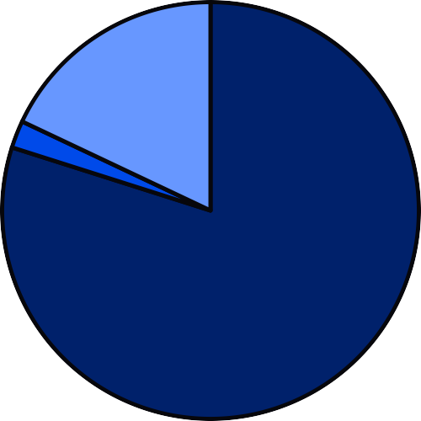



Customer Segmentation & Revenue by Age
Customer Segmentation
Customers classiried into New, Peturning, and Loyal segments based on purchase history.
Revenue by Age Croup
Total revenue contribution or each age group.
$75,000.00
$50,000.00
$25,000.00
$0.00
Young 6dult
Middle-aged
6dult
Senior
Loyal
New
Peturning

Slide 8
Power BI Dashboard: Key Metrics
An interactive dashboard in Power BI presents insights visually.
3.9K
Customers
$59.76
Avg. Purchase Amount
3.75
Avg. Review Rating

Slide 9
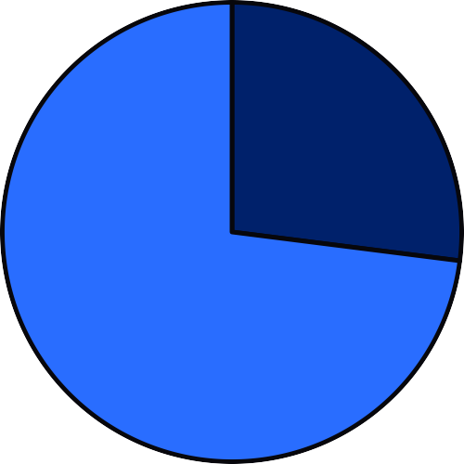

Dashboard Visualizations
% of Customers by Subscription Status
Revenue by Category
$90,000.00
$G0,000.00
$30,000.00
Yes
No
$0.00
Clothing
6ccessories
Footwear
Outerwear

Slide 10
Business Recommendations
Boost Subscriptions
Promote exclusive benefits for subscribers to increase sign-ups.
Customer Loyalty Programs
Reward repeat buyers to foster loyalty and move them into the <Loyal= segment.
Review Discount Policy
Balance sales boosts with margin control to optimize profitability.
Product Positioning
Highlight top-rated and best-selling products in marketing campaigns.
Targeted Marketing
Focus efforts on high-revenue age groups and express-shipping users for maximum impact.

